Slide 1
Monday

Slide 2

Beginning of Class
Warm-up
Agenda
1st – Fill out your Agenda.
2nd – Unpack and put your backpack (and any other “bags” at the front of the room or at the back of the room. )
3rd – Get your notebook.
4th – Work on the warm-up
In Class – Start Classification Foldable
Homework –
  Choices (Due Thursday)

Slide 3
Monday, September 26, 2016
OBJECTIVES
In Class
Start the Taxonomy Foldable
Essential Question(s):
How can we classify living things?
Learning Objective:
I can classify an organism using the Linnean system of classification.

Slide 4

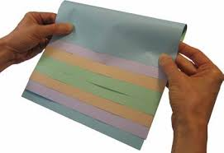
Folding Instructions
1. Line up 5 sheets of paper with approximately ½- ¾ inch spaces.
2. Fold papers over the top and line them up to make 10 “flaps”.

Slide 5
TAXONOMY
LIFE’S FILING SYSTEM
DOMAIN
KINGDOM
PHYLUM
CLASS
ORDER
FAMILY
GENUS
SPECIES
Binomial Nomenclature
Domain
Kingdom
Phylum
Class
Order
Family
Genus
Species
Binomial Nomenclature

Slide 6
Domain Page
Humans Domain: Eukarya
My Organism’s Domain: Eukarya
What this means about its structure: My organism has cells with a nucleus that contains DNA.
Archaea | Bacteria | Eukarya
Lives in harsh environments Single-celled | Lives almost everywhere Single-celled | Multicellular Cells nucleus contains DNA
3 Domains – Grouped according to cell type, habitat and cell membrane material.

Slide 7

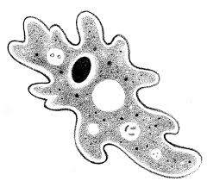


Kingdom Page
Humans Kingdom: Animalia
My Organism’s Kingdom: Animalia
What this means about its structure: My organism is multicellular and can’t make its own food.
Kingdoms in Eukarya:
Animals Plants Fungi Protists
Grouped based on cell type, number of cells and how they obtain food.

Slide 8
Tuesday

Slide 9
Beginning of Class
2 minutes
Agenda
Warm-up
In Class – Finish Classification Foldable
Homework –
  Choices (Due Thursday)
1st – Fill out your Agenda.
2nd – Unpack and put your backpack (and any other “bags” at the front of the room or at the back of the room.
3rd – Get your notebook.
4th – Work on the warm-up
Warm-up:
Finish the “Kingdom” page in your foldable.

Slide 10
Kingdom Page
Humans Kingdom: Animalia
My Organism’s Kingdom: Animalia
What this means about its structure: My organism is multicellular and can’t make its own food.
Kingdoms in Eukarya:
Animals Plants Fungi Protists
Grouped based on cell type, number of cells and how they obtain food.

Slide 11
Tuesday, September 27, 2016
OBJECTIVES
In Class
Finish the Taxonomy Foldable
Essential Question(s):
How can we classify living things?
Learning Objective:
I can classify an organism using the Linnean system of classification.

Slide 12
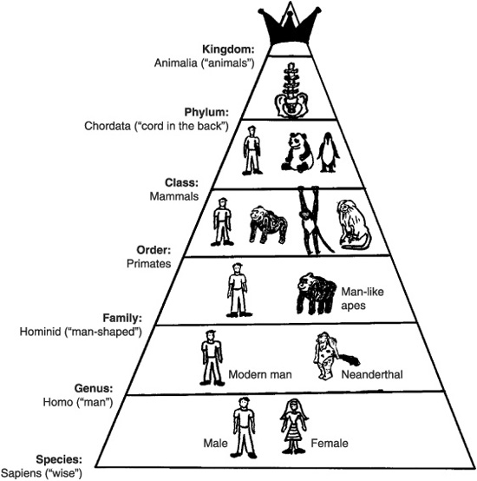
Phylum Page
Humans Phylum: Chordata
My Organism’s Phylum:
What this means about its structure:
Phylum:
Phylum is after Kingdom and before Class

Slide 13
Class Page
Humans Class: Mammalia
My Organism’s Class:
What this means about its structure:
Class:
Class is after Phylum and before Order

Slide 14
Order Page
Humans Order: Primates
My Organism’s Order:
Order:
Order is after Class and before Family

Slide 15
Family Page
Humans Family: Hominid
My Organism’s Family:
Family:
Family is after Order and before Genus

Slide 16
Genus Page
Humans Genus: Homo
My Organism’s Genus:
Genus:
After Family and before Species
Part of binomial nomenclature
EXAMPLE: Felis catus-cat
genus species

Slide 17
Species Page
Humans Genus: sapiens
My Organism’s Genus:
Species:
After Genus
Most specific level
Part of binomial nomenclature
EXAMPLE: Felis catus-cat
genus species

Slide 18
Wednesday

Slide 19
Beginning of Class
Agenda
Warm-up
In Class – Finish Classification Foldable
Homework –
  Choices (Due tomorrow)
1st – Fill out your Agenda.
2nd – Unpack and put your backpack (and any other “bags” at the front of the room or at the back of the room.
3rd – Get your notebook.
4th – Work on the warm-up
Warm-up (Next open page in notebook):
What are the levels of classification of living things from largest to smallest. Start with DOMAINS.

Slide 20
Wednesday, September 28, 2016
OBJECTIVES
In Class
Finish Foldable
Essential Question(s):
How can we classify living things?
Learning Objective:
I can compare the relatedness of an organism based on their classification.

Slide 21
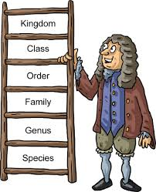
Binomial Nomenclature Page
Binomial Nomenclature
Two Name Naming System
​Scientists use the levels Genus and Species to give organisms a unique name.
Developed by Carolus Linneaus (The “father of taxonomy”)
Humans Scientific Name: Homo Sapiens or Homo sapiens
My Organism’s Scientific Name:

Slide 22
Add your organism!
Choose an animal from the handout and use that to fill in the rest of the foldable for the “my organism” parts.

Slide 23
What this means about structure:
Phylum | Class
Chordata – chord running down the back. | Mammalia -have body hair and feed their young with milk
 | Insecta - "cut into sections"
Mollusca – mostly marine species | Cephalopoda – “head foot”
 | Chondrichthyes - cartilaginous fishes
Anthropoda – jointed legs | Aves - Birds
 | Reptilia – Reptiles
 | Actinopterygii - ray-finned fishes
Notes:
This page contains the meanings of the different phylums and classes of the animals students could choose from.

Slide 24
Under your warm-up for today:
My organism, the _____________ is similar to humans to the _________ level. This means that the ________________ is (very/somewhat/not very) similar to humans.
Classification of organisms is important because……

