Slide 1
Plant Vs. Animal Cells
What’s what?

Slide 2
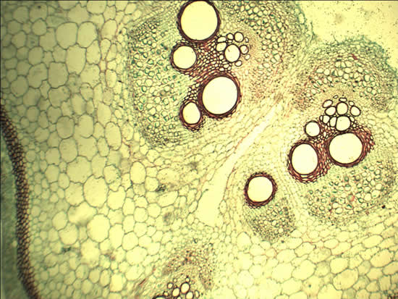
Which one? (Number 1)

Slide 3
How can you tell?
Look for structures to distinguish them from each other.
Large central Vacuoles
Chloroplasts
Cell Walls

Slide 4
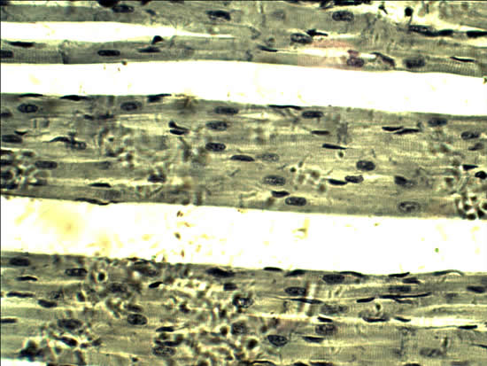
What about this one? (Number 2)

Slide 5
What’s missing?
Is there a cell wall?
Is there a large central vacuole?
What can you identify?
Nucleus

Slide 6
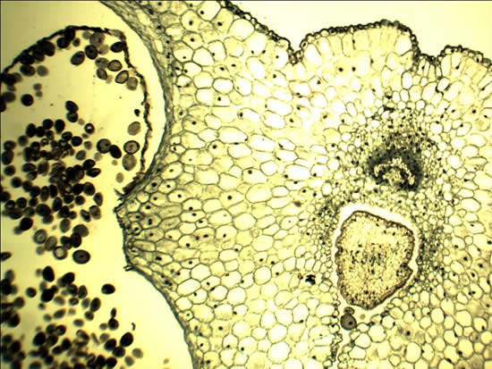
You’re on your own (Number 3)

Slide 7
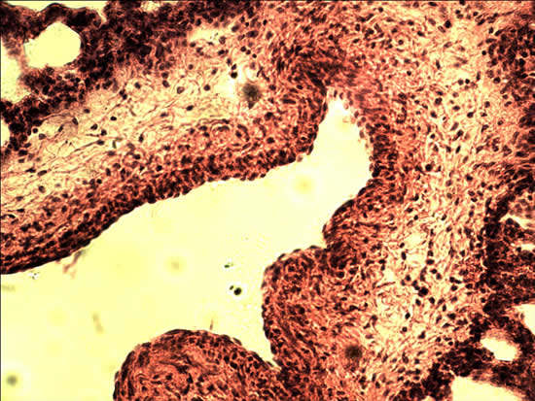
Try this one (Number 4)

Slide 8
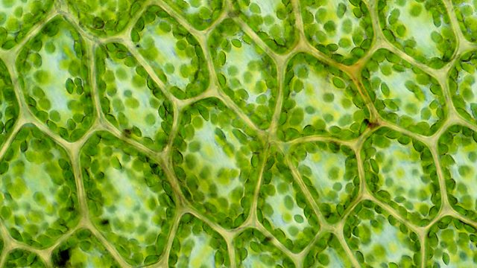
Last one (Number 5)

